Slide 1
Presentation 1
Camilo Aguilar

Slide 2
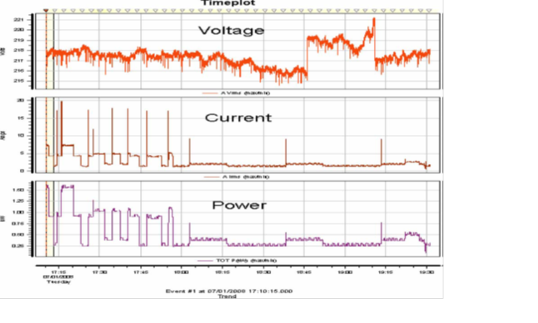
Load Signature
Electrical behavior
Understand and analyze:
Control devices
Energy Management

Slide 3
Variables Load Signatures
Voltage (V)
Current (i)
Power (P)

Slide 4
1 appliance vs n appliances

Slide 5
Principle Superposition = Composite Load

Slide 6
Composite Load
Unique features from appliances are mixed
Certain features may be masked or lost. Decompose signals:
Snapshot Form: Instantaneous snapshot of the load behavior taken at a fixed time intervals.
Delta Form: Difference between two consecutive snapshots form signatures.

Slide 7
Criteria to Classify Composite waveforms
Current waveform
Active and reactive power
Harmonics
Instantaneous Admittance Waveform
Instantaneous Power Waveform
Eigen Values

Slide 8
Propositions
Set a fix interval
Normalize the data
Set a threshold variation. (difference in voltage, power, current)
Detect events by switching on/off appliances.
By analyzing delta forms, and using an algorithm, extract feature changed.
With a known database of features, match database with change in composite load signature.

Slide 9
Long Term Goals
Implementing knowledge about load signature decomposition with hardware
Developing the program that will recognize each appliance

